Slide 1
03. Dynamic Programming (1)
Design and Analysis of Algorithm (DAA) 2
2016/2017
Abdul Munif

Slide 2
Agenda
Example Case: Cut Rod/Rod Cutting
Overlapping sub problems
Recurrence
Pseudocode → implementation

Slide 3
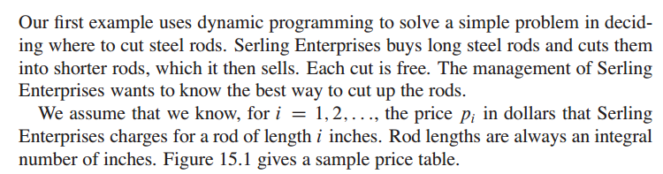
Problem Definition

Slide 4
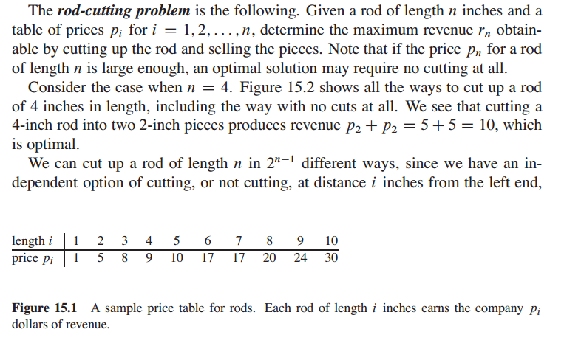
Problem Definition

Slide 5
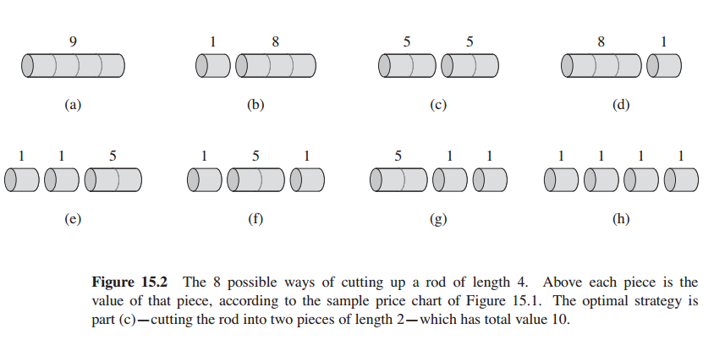
Problem Definition

Slide 6
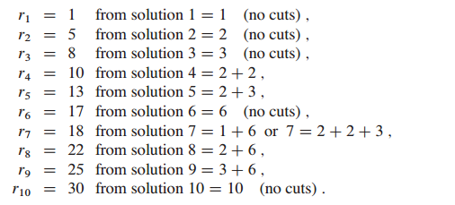
What is the overlapping sub problem from this example? –Observation-
Overlapping problem/optimal substructure
Optimal solutions to a problem incorporate optimal solutions to related subproblems, wich we may solve independently.

Slide 7
Deciding the correct recurrence -Abstraction-

Slide 10
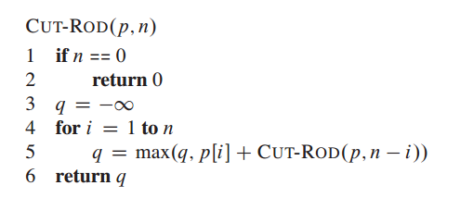
Recursive Solution

Slide 11
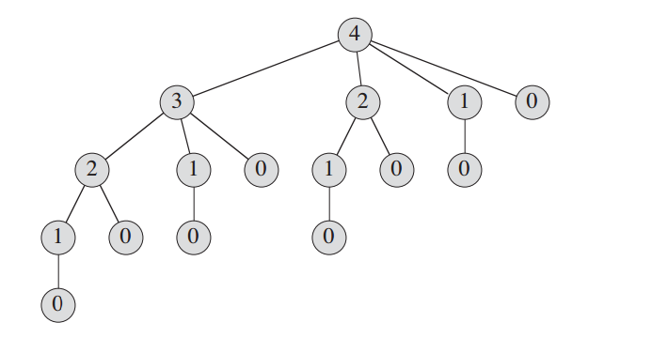
Recursion Tree

Slide 12
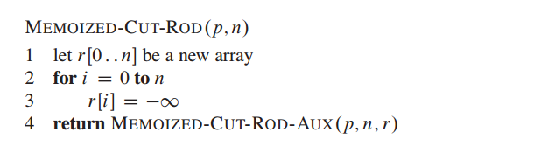
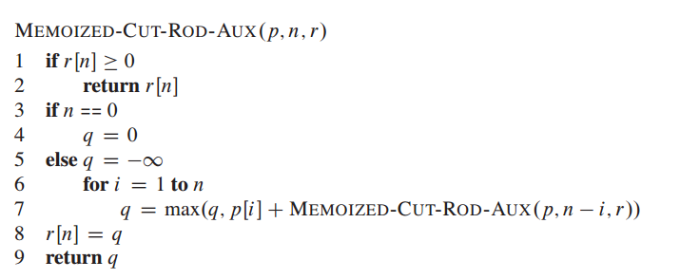
DP Top Down

Slide 13
DP Top-Down
Cut-Rod (p, n)
1. if n = 0
2. memo[n] = 0
3. return memo[n]
4. if memo[n] != 0
5. return memo[n]
6. q = -inf // we are not using q = 0
7. for i = 1 to n
8. q = max (q, p[i] + Cut-Rod(p, n-i))
9. memo[n] = q
10. return memo[n]

Slide 14
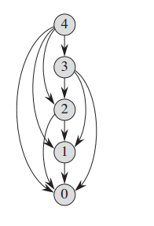
Subproblem graph
The set of subproblems involved and how subproblems depend on one another

Slide 15
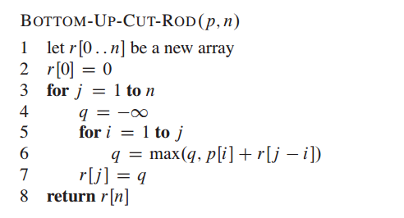
DP Bottom Up

Slide 16
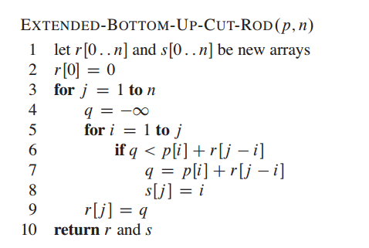
Reconstructing a solution

Slide 17
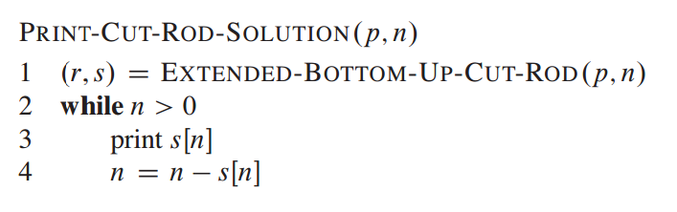
Print the solution

Slide 18
Exercise
Buying Apples (http://www.spoj.com/problems/ABA12C)

Slide 19
Terminology
overlapping sub problem/optimal substructure
recurrence
memo table
DP bottom up
DP top down
sub problem graphs

